Slide 1

Non Functional aspects of web
Aruna S
Department of
Computer Science and Engineering

Slide 2

Non functional aspects of web
Caching
S. Aruna
Department of Computer Science and Engineering

Slide 3
Caching
Introduction
Cache is a type of memory that is used to increase the speed of data access.
Normally, the data required for any process resides in the main memory.
It is transferred to the cache memory temporarily if it is used frequently enough.
The process of storing and accessing data from a cache is known as caching.

Slide 4
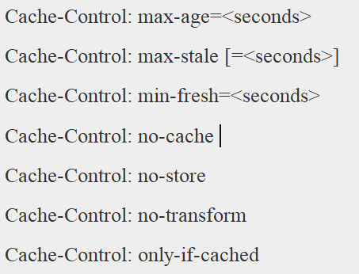
Caching
Cache-Control Header
Cache-control is an HTTP header used to specify browser caching policies in both client requests and server responses. Policies include how a resource is cached, where it’s cached and its maximum age before expiring (i.e., time to live).
Standard Cache-Control directives that can be used by the client in an HTTP request.

Slide 5
Caching
Cache-Control Header - Expiration
max-age=<seconds>
The maximum amount of time a resource is considered fresh. Unlike Expires, this directive is relative to the time of the request.
s-maxage=<seconds>
Overrides max-age or the Expires header, but only for shared caches (e.g., proxies). Ignored by private caches.
max-stale[=<seconds>]
Indicates the client will accept a stale response. An optional value in seconds indicates the upper limit of staleness the client will accept.
min-fresh=<seconds>
Indicates the client wants a response that will still be fresh for at least the specified number of seconds.

Slide 6
Caching
Additional HTTP cache headers
In addition to cache-control, notable HTTP cache headers include:
Expires – This header specifies a fixed date/time for the expiration of a cached resource. For example, Expires: Sat, 13 May 2017 07:00:00 GMT signals that the cached resource expires on May 13, 2017 at 7:00 am GMT. The expires header is ignored when a cache-control header containing a max-age directive is present.
ETag – A response header that identifies the version of served content according to a token – a string of characters in quotes, e.g., "675af34563dc-tr34" – that changes after a resource is modified. If a token is unchanged before a request is made, the browser continues to use its local version.
Vary – A header that determines the responses that must match a cached resource for it to be considered valid. For example, the header Vary: Accept-Language, User-Agent specifies that a cached version must exist for each combination of user agent and language.

Slide 7
Caching
Additional HTTP cache headers
Disk cache is RAM memory, that contains a copy of the information on the disk. Typically, when you access something on the drive, the whole page is brought into cache, on the assumption that the next access will be in that page. The first disk seek might take 8ms, while seeks from cache 100 ns
Memory cache is the same concept, but the cache is located on the CPU chip. So the original memory access is 100ns, the L1 cache access can be 0.5 ns.
Browser cache is similar, but stores resources like images, javascript files, etc. on your hard-drive instead of the web page. Once you access a website, these static resources are stored locally in the browser cache for quicker access the second time you need it.

Slide 8
THANK YOU
Aruna S
Department of
Computer Science and Engineering
arunas@pes.edu

